Slide 1
Large-Scale and Multi-Structured Databases
Project Design
BeerHub
Marco Lari, Luca Minuti, Tommaso Pellegrini

Slide 2
Application Highlights
BeerHub is an application designed for beer lovers to explore, compare and share experiences about thousands of beers from around the world.
Browse and filter beers by style, country, brewery and ABV
View detailed beer profiles enriched with user reviews
Write and manage personal reviews
Follow breweries to stay updated on their beers
Discover similar users through graph-based analytics
Find “drinking buddies” with shared tastes and location
Simple and intuitive interface, accessible to all types of users
Notes:
BeerHub is an application designed to allow users to easily explore a large collection of beers obtained from multiple real-world sources. The application enables beer search through several criteria, provides detailed beer information, and allows users to read reviews written by other users.
Registered users can contribute by sharing their own evaluations and by following the breweries they are interested in. There is also a social part of the application: the system identifies users with similar taste profiles, helping them discover people with comparable preferences.
In this slide we can see the main features of the application.

Slide 3
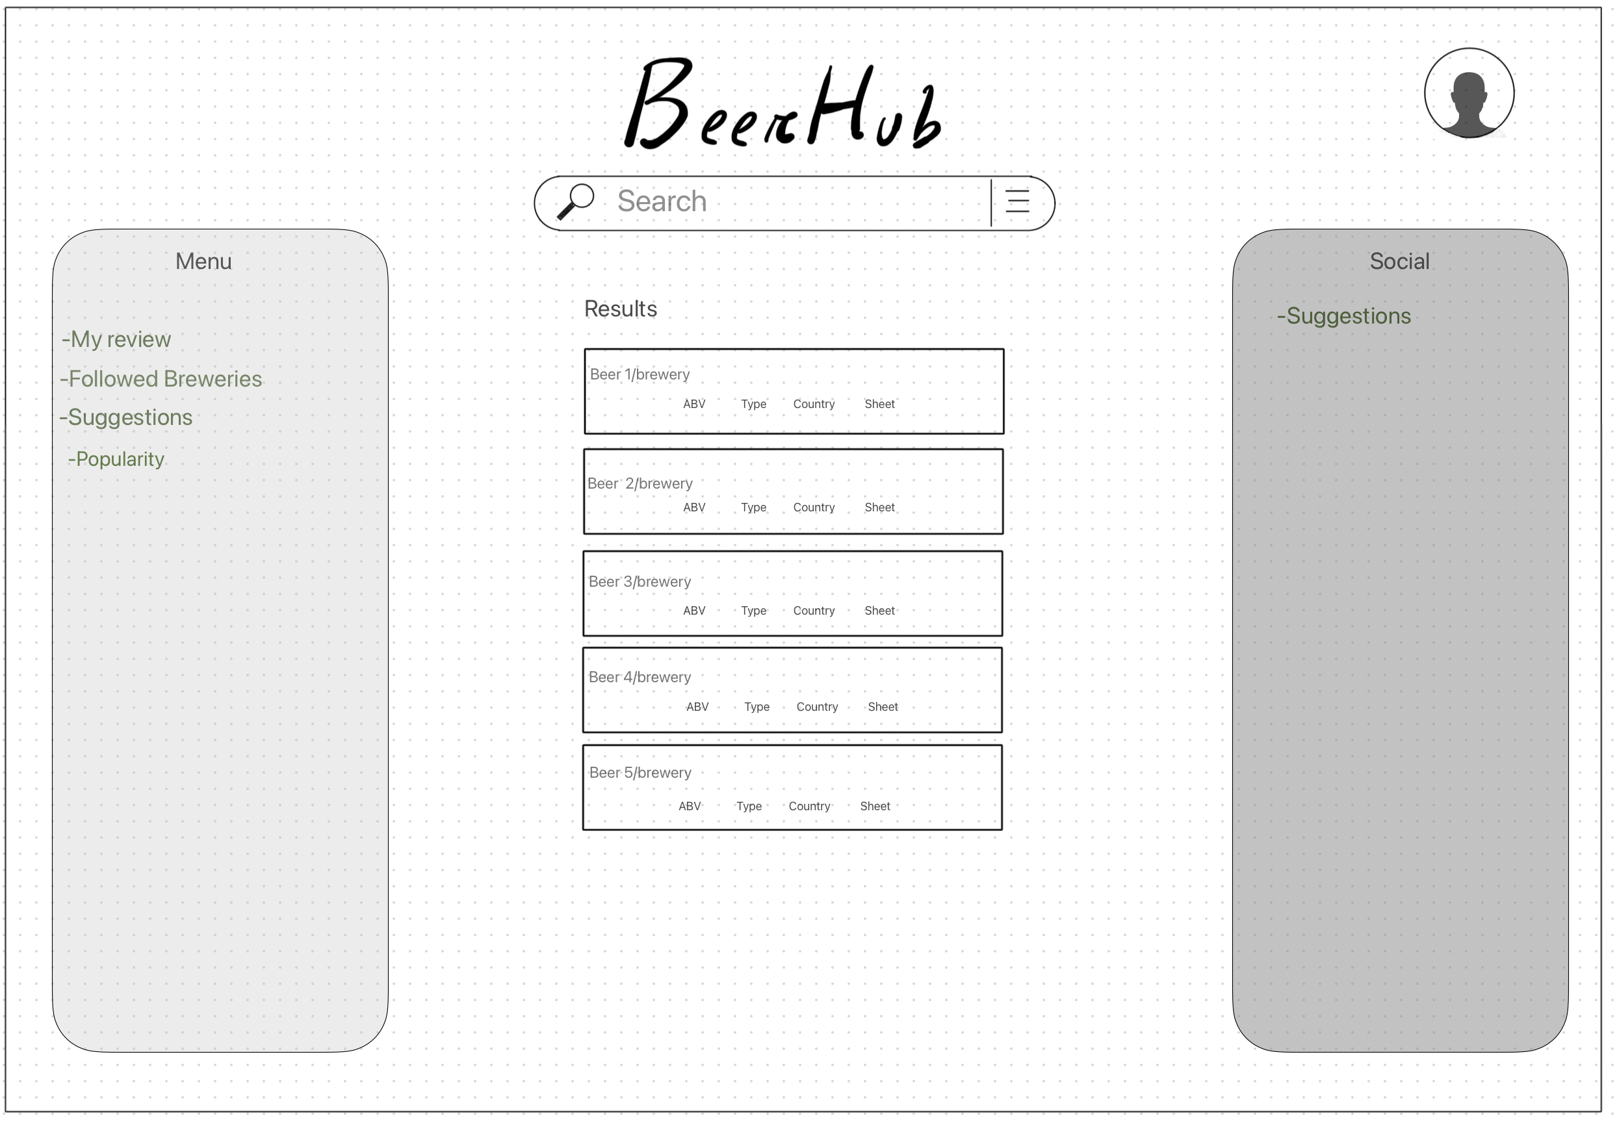
Actors and main mock-ups (i)
Actors
Unregistered user: can do the sign up. He can browse beers and breweries and see their details.
Registered user: can use all the features of the application.
Administrator: manages users and datasets. He can delete reviews and bad users.
Notes:
The system involves three main actors.
The unregistered user can sign up and browse beers and breweries, viewing their details but without being able to write reviews or access personalised suggestions.
The registered user can use all the features of the application, including writing reviews and receiving recommendations.
The administrator manages users and datasets and can moderate or remove inappropriate reviews.
We can also se the mockup for the main page of the app, in which a user can access to the browsing function with filters for beers and breweries and the results are shown as a list below. A registered user can also access higher level functionalities such as suggestion, simple statistics and review writing, and to social functionality too.

Slide 4
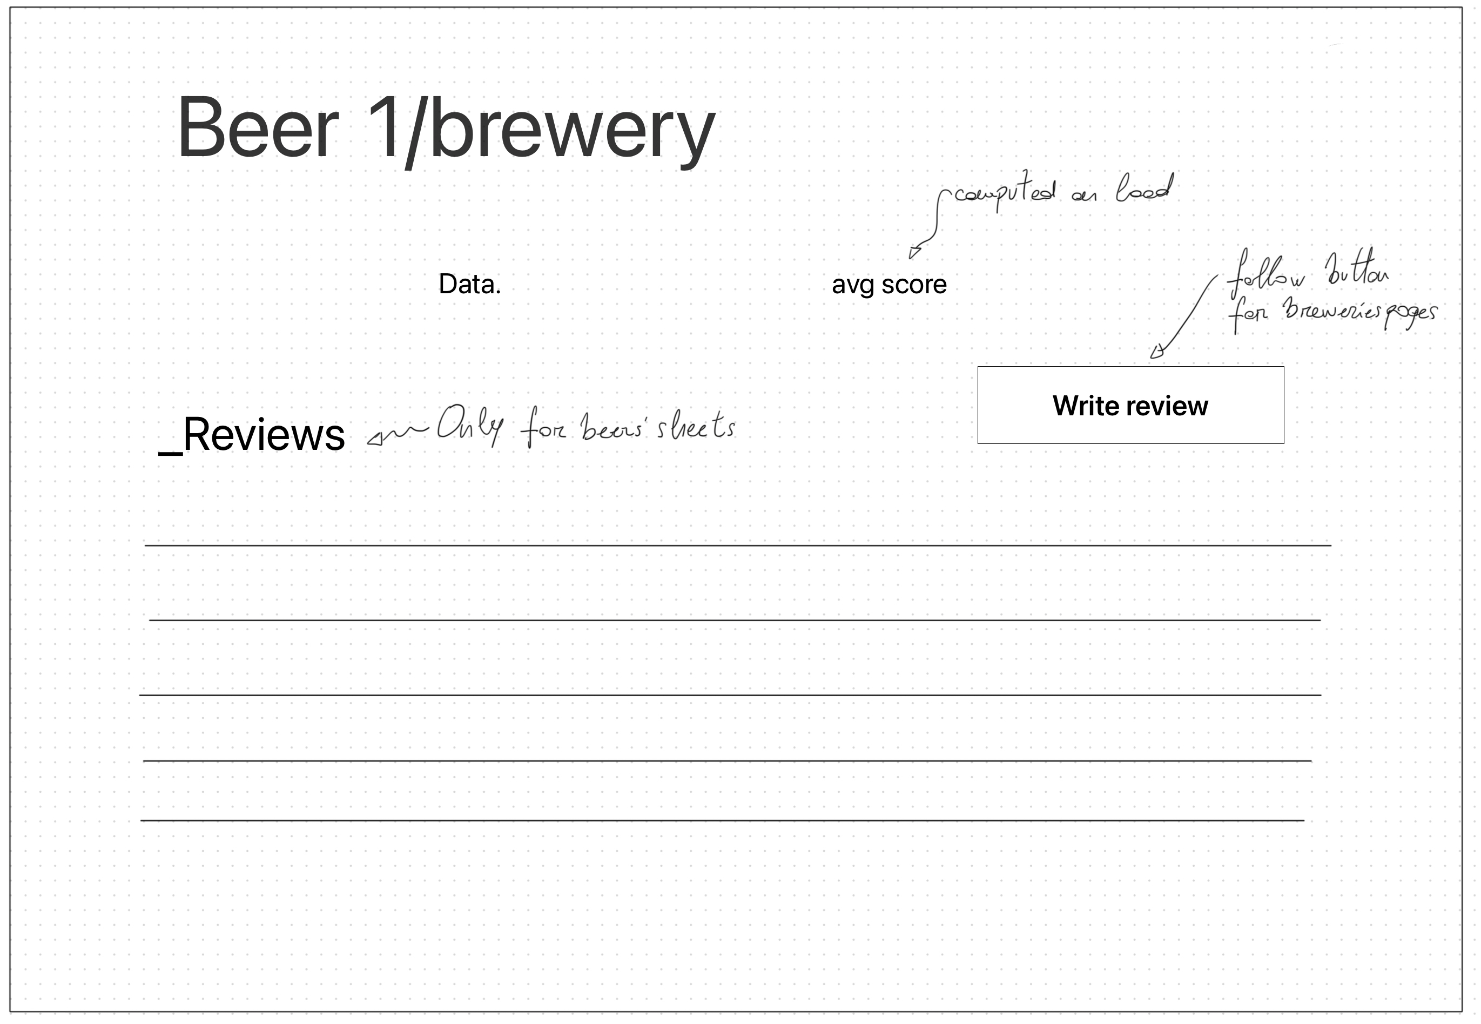
Actors and main mock-ups (ii)
Notes:
In the second mockup we see the tab for beer and breweries where info is shown. On the beer tab we can look at the avg score computed from ratings, read latest reviews and a registered user may write its own review. On the brewery tab one can read the main info about it, look at a list of beers produced by it and a registered user will be able to follow / unfollow it.

Slide 5
Dataset Description
Source: Kaggle-Brewery Dataset, OpenDataBay-Beer Profile, RandomUser API
Description: Dataset integrating information about beers, breweries, reviews and synthetic users. Includes beer attributes (name, style, ABV, brewery, country), brewery data (id, name, location), review data (score, text, date) and user profiles (username, age, city, country).
Volume: 28MB (beers) + 3MB (breweries) + 24MB (reviews) + 1MB (users) = 56MB
Variety: Guaranteed using multiple independent sources (Kaggle, OpenDataBay, RandomUser) and by the integration of the two beer datasets, which required aligning attributes and combining different types of information such as beer details, brewery data, review text and user demographics.
Notes:
This project integrates data from three different sources: Kaggle for beers and breweries, OpenDataBay for beer profiles and ratings, and RandomUser for the generation of synthetic user profiles.
The combined dataset contains information about beers and their characteristics, breweries, user reviews, and synthetic user profiles aligned with the reviews, for a total volume of about 56MB.
We ensured data variety using multiple independent sources, but also from the integration of the two beer datasets from Kaggle and OpenDataBay. Overall, the dataset contains several types of information — beer characteristics, brewery information, review text and user demographics — which contribute to its heterogeneity.

Slide 6
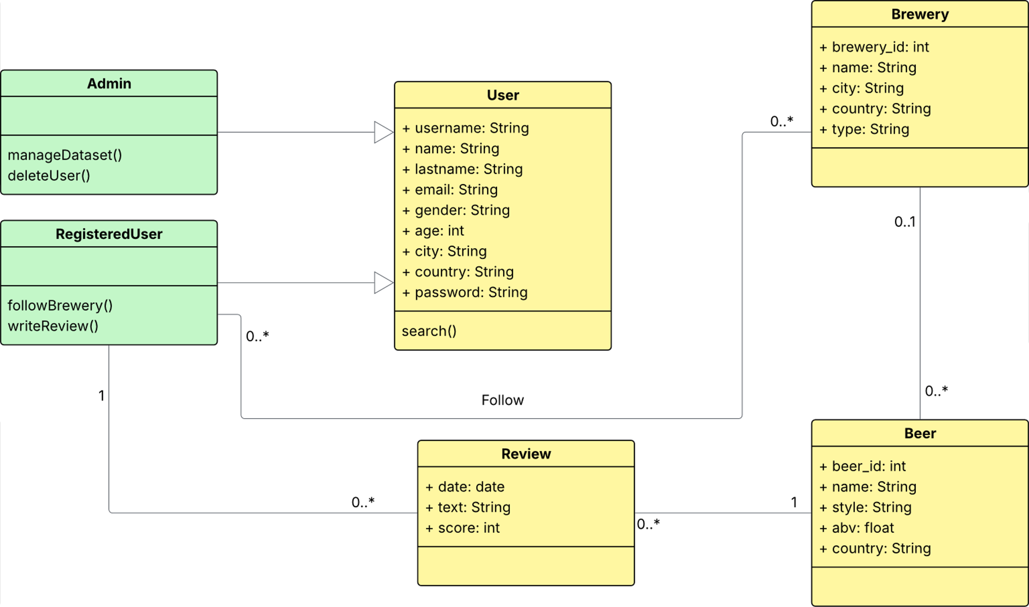
Preliminary UML Class Diagram
Notes:
This is the preliminary UML class diagram of our application. Here we give an overview of the main domain entities and how they are conceptually related.
Here we are three user roles — Unregistered User, Registered User and Admin — each with the actions they can perform in the system.
At the center of the domain we have the User class, which contains the core user information. Registered users can write reviews and follow breweries, while admins can manage the dataset and user accounts. Unregistered users can only login and signup.
The main entities of the domain are User, Review, Beer, and Brewery, connected through simple associations: users write reviews, reviews refer to specific beers, and each beer is produced by a single brewery. Every user has the possibilty to follow one or more breweries. This diagram summarizes the logical structure of the system and the interactions that will guide our database design in the next phase.

Slide 7
Relevant Queries and Entities handled by Document DB
Most relevant functional requirements:
View detailed beer information
Browse and filter beers by style, country, brewery and ABV range
Show reviews for a selected beer (with score and text)
Suggest beers based on user attributes
Compute average rating and number of reviews for a selected beer
Find the most common beer style for a user-selected country
Entities
Beers
Breweries
Reviews
Users
Notes:
Here we summarize the functional requirements that are managed by the Document Database.
The first requirement is the ability to view detailed information about a selected beer.
We also allow users to browse and filter beers by different attributes or to show all reviews for a selected beer, including both the score and the text.
We also support beers suggestions based on user attributes such as favorite styles or regions according to the reviews made by the user himself.
A key analytical feature is computing the average rating and the total number of reviews for a beer. (SE CHIEDE: When a user opens the Beer Details page, the application performs an aggregation on the reviews collection to compute the average score and the total number of reviews for that beer. The results are then displayed in the page (e.g., “Average rating: 4.21 — 153 reviews”))
And finally, we use Document DB to find the most common beer style for a user-selected country. ( SE CHIEDE:The user selects a country in the browse/filters section. The application runs an aggregation on the beers collection to determine the beer style with the highest number of beers in that country.)
The main entities involved are: beers, breweries, reviews and users.

Slide 8
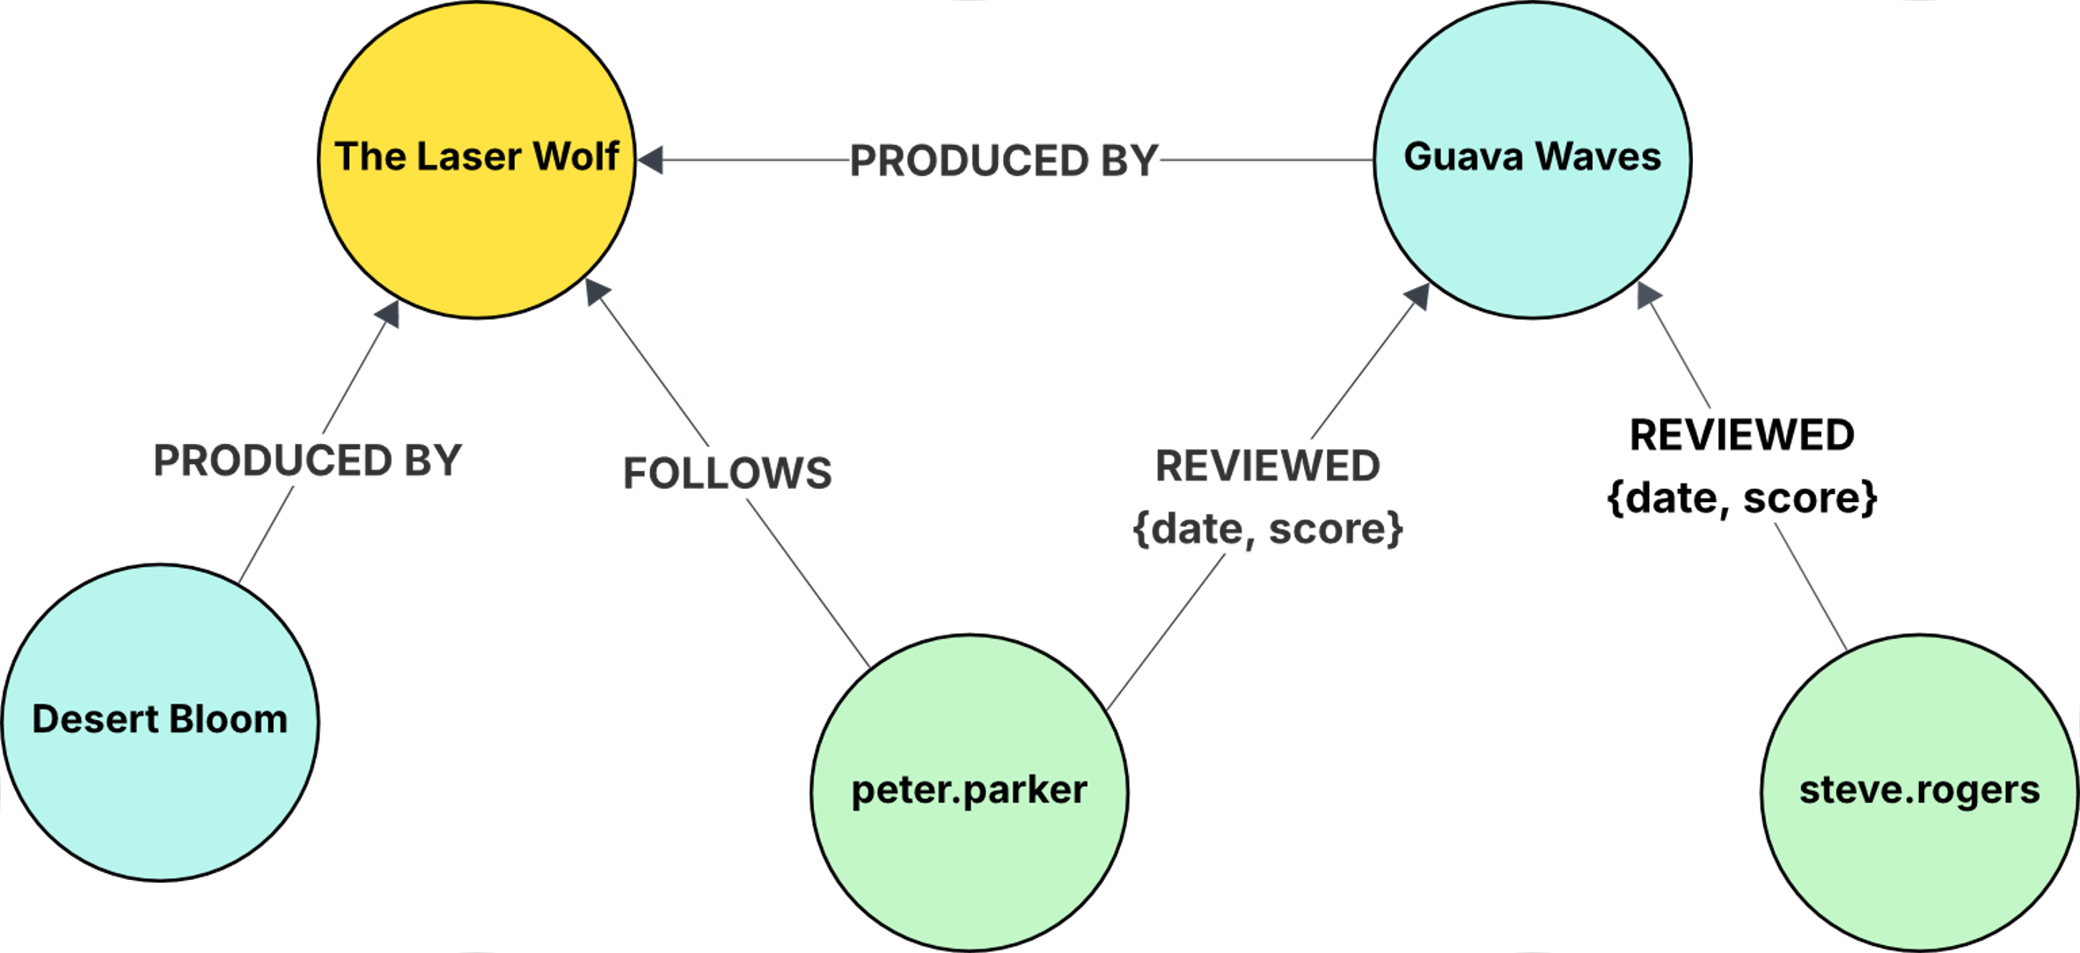
Requirements and Entities handled by Graph DB
Most relevant functional requirements:
Find users with similar tastes.
Recommend breweries to follow based on similar users.
Suggest drinking buddies (same city + similar tastes).
Entities
Beer
Brewery
User
Notes:
Prima query: Identify users with similarbeer preferences by analyzing their ratings and reviews on theuser–beer graph. Seconda query: Suggeriamo birrifici che utenti con gusti simili già seguono,usando le relazioni REVIEWED e FOLLOWS nel grafo. Terza query: Recommend“drinking buddies” by finding users who share similar beer profilesand live in the same city.
The secondary database used is a graphDB, that responds to the functional requirements focused on relations and social functionalities of the application. The entity will be Beer, Brewery and User and the possible edges will be: from beer (blue) to brewery (yellow) produced by, from user (green) to brewery (yellow) follows and from user (green) to beer (blue) review.
The main queries that will be done on this are to find users with similar taste, recommend breweries to follow and suggest drinking buddies.

